Slide 1

KALINGA INSTITUTE OF INDUSTRIAL TECHNOLOGY
Data Structures and Algorithms (CS-2001)
School of Computer Engineering
Strictly for internal circulation (within KIIT) and reference only. Not for outside circulation without permission
4 Credit
Lecture Note

Slide 2

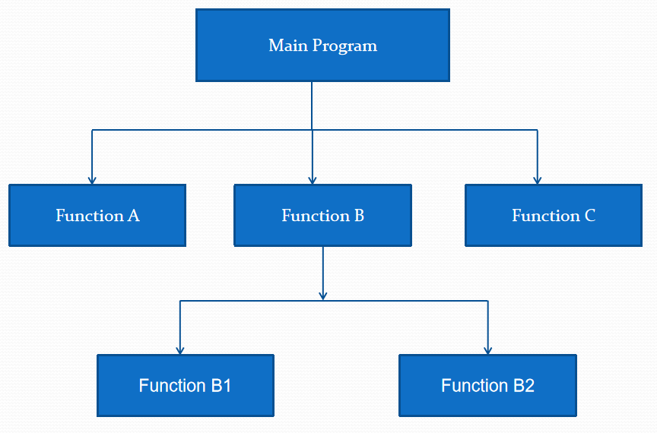
Function
10
The program becomes large and complex
A lengthy program can be coded separately into
sub-programs called as Functions
For repetition of certain part of code

Slide 3
Function Definition
10
The general form of function definition statement in C is as follows:
return_data_type function_name (data_type variable1,...) Function header
{
declarations;
statements; return(expression);
Function Body
}
function_name :
This is the name given to the function
it follows the same naming rules as that for any valid variable in C.
return_data_type:
This specifies the type of data given back to the calling construct by the function after it executes its specific task.

Slide 4
Passing Values between Function
11
int main()
{
int a, b, c, sum ;
printf ( "\nEnter any three numbers " ) ; scanf ( "%d %d %d", &a, &b, &c ) ;
sum = calsum ( a, b, c ) ;
printf ( "\nSum = %d", sum ) ; return 0;
}
calsum ( int x, int y, int z )
{
int d ;
d = x + y + z ; return d ;
}

Slide 5
Passing Values between Function
11
int main()
{
int a, b, c, sum ;
printf ( "\nEnter any three numbers " ) ; scanf ( "%d %d %d", &a, &b, &c ) ;
sum = calsum ( a, b, c ) ;
printf ( "\nSum = %d", sum ) ; return 0;
}
int calsum ( int x, int y, int z )
{
int d ;
d = x + y + z ; return d ;
}
a, b, c are called actual arguments
x, y and z are called formal
arguments
main is the calling function and
calsum is the called function

Slide 6
Function return statement
12

Slide 7
Function return statement
12
There is no restriction on the number of return statements that may be present in a function. Also, the return statement need not always be present at the end of the called function. The following program illustrates these facts.
int fun( )
{
char ch ;
printf ( "\n Enter any alphabet " ) ; scanf ( "%c", &ch ) ;
if ( ch >= 65 && ch <= 90 ) return ( ch ) ;
else
return ( ch + 32 ) ;
}

Slide 8
Scope Rule of Functions
13
In this program is it necessary to pass the value of
the variable i to the function display( )? Will it not
display ( int j )
{
int k = 35 ;
printf ( "\n%d", j ) ;
printf ( "\n%d", k ) ;
}
become automatically available to the function
display( )? No. Because by default the scope of a
variable is local to the function in which it is defined. The presence of i is known only to the function main( ) and not to any other function. Similarly, the variable k is local to the function display( ) and hence it is not available to main( ). That is why to make the value of i available to display( ) we have to explicitly pass it to display( ). Likewise, if we want k to be available to main( ) we will have to return it to main( ) using the return statement. In general we can say that the scope of a variable is local to the function in which it is defined.
int main( )
{
int i = 20 ; display ( i ) ; return 0;
}

Slide 9
Function Call by Value and Call by Reference
14
Whenever we called a function and passed something to it we have always passed the ‘values’ of variables to the called function. Such function calls are called ‘calls by value’. By this what we mean is, on calling a function we are passing values of variables to it. The examples of call by value are shown below:
sum = calsum ( a, b, c ) ;
We have also learnt that variables are stored somewhere in memory. So instead of passing the value of a variable, can we not pass the location number (also called address) of the variable to a function? If we were able to do so it would become a ‘call by reference’.
Arguments can generally be passed to functions in one of the two ways:
sending the values of the arguments
sending the addresses of the arguments

Slide 10
Function Call by Value and Call by Reference
15
Call by Value
Call by Reference
swapByValue ( int x, int y )
{
int t ; t = x ; x = y ; y = t ;
printf ( "\nx = %d y = %d", x, y ) ;
}
int main( )
{
int a = 10, b = 20 ;
swapByValue( a, b ) ;
printf ( "\na = %d b = %d", a, b ) ; return 0;
}
swapByRef ( int *x, int *y )
{
int t ; t = *x ;
*x = *y ;
*y = t ;
printf ( "\nx = %d y = %d", *x, *y ) ;
int main( )
{
int a = 10, b = 20 ;
swapByRef( &a, &b ) ;
printf ( "\na = %d b = %d", a, b ) ; return 0;
}
}

Slide 11
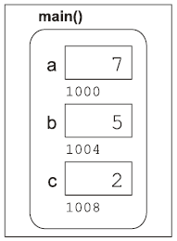
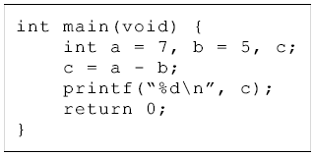
Pointers
16
Storing Variable in Memory
The value inside a box indicates the value in that memory location.
The value under a box is the memory address of that box.

Slide 12

Pointers
16
When we declare a variable and initialize it,
int quantity = 179 ;
quantity variable
179 value
5000 address
Since memory address are simple numbers they can be assigned to some other variables
Pointers

Slide 13
Pointers
16
Pointer is an entity which contains memory address
Pointers can be used to access data stored in memory
There are two operators for pointers
address operator ‘&’
Dereference operator ‘*’ (value of operator)

Slide 14
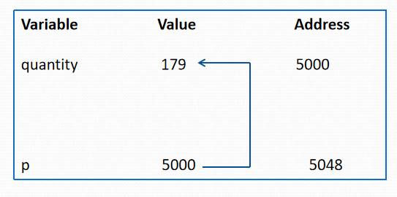
Pointers
16

Slide 15
Accessing Address of a Variable
16
main( )
{
int i=3;
printf(“\n Address of i = %u”,&i);
printf(“\n Value of i = %d”,i);
}
OUTPUT :
Address of i = 6485
Value of i =3

Slide 16
Declaring pointer Variables
16
The declaration is done as follows
data_type *pt_name;
* tells that pt_name is a pointer variable
pt_name needs memory location
pt_name points to a variable of type data_type
Remember data_type tells the type of data pointer will point to and not the value of pt_name
Example
int *p;
float *x;

Slide 17
Initialization of pointer variables
16
int quantity;
int *p; //declaration
p=&quantity; //initialization
int x, *p=&x; // all steps in one
// Assignment of NULL or 0 (zero)
int *p=NULL;
int *p=0;
// this is invalid, absolute address
int *p=5360;

Slide 18
Accessing Variable Through its Pointer
16
* operator known as
Indirection operator
Dereference operator
Example
int a,*p, n; //declaration
a=179; // variable assignment
p=&a; // pointer initialization
n=*p; //value at address operator
When * is placed at declaration it is used creating a pointer
* placed on right hand side of expression it returns the value at a address. In this case it will return 179

Slide 19
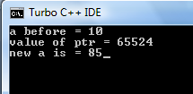
Accessing Variable Through its Pointer
16
#include<stdio.h>
main()
{
int a=10;
int *ptr;
printf("a before = %d",a);
ptr=&a;
printf("\nvalue of ptr = %u", ptr);
*ptr=85;
printf("\nnew a is = %d",a);
getch();
}

Slide 20
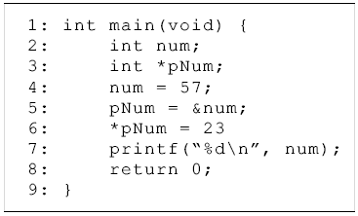
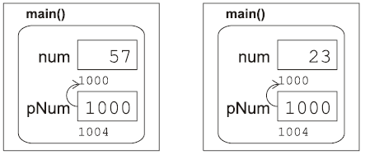
16

Slide 21
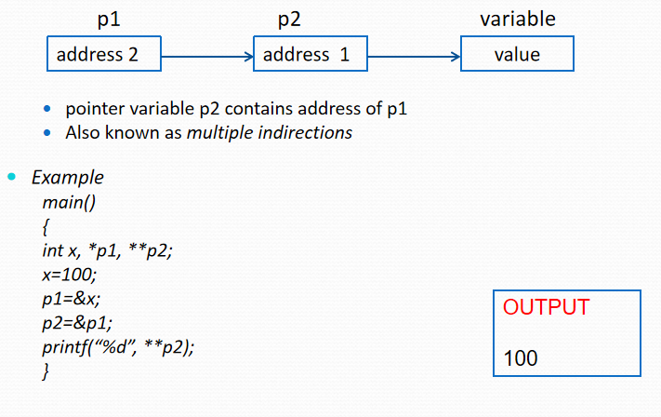
Chain of Pointers
16

Slide 22
Pointer Expression
16
Following statements are valid
y=*p1 * *p2;
sum=sum+*p1;
z=5*(-(*p2))/ *p1;
Two pointers cannot be used for division or multiplication

Slide 23
Pointer Increments and Scale Factors
16
Pointers can be incremented like
p1=p1+2;
p1=p1+1;
Expression like
p1++
will cause pointer to next value of its type

Slide 24
Structure
16
Arrays allow to define type of variables that can hold several data items of the same kind. Similarly structure is another user defined data type available in C that allows to combine data items of different kinds.
Structures are used to represent a record. Suppose you want to keep track of your books in a library. You might want to track the following attributes about each book −
Title
Author
Subject
Book ID
Defining the Structure:
Book Structure
Access Structure Elements
struct [structure tag]
{
member definition; member definition;
...
member definition;
} [one or more structure variables];
struct Books
{
char title[50]; char author[50]; char subject[100]; int book_id;
} book;
/* Declare Book1 of type Book */ struct Books Book1;
/* Declare Book2 of type Book */ struct Books Book2;
Book1.title =“DSA”; Book2.book_id = 6495700;

Slide 25
Union
17
Unions are quite similar to the structures in C. Union is also a derived type as structure. Union can be defined in same manner as structures just the keyword used in defining union in union where keyword used in defining structure was struct.
You can define a union with many members, but only one member can contain a value at any given time. Unions provide an efficient way of using the same memory location for multiple-purpose.
Defining the Union:
Data Union
Access Union Elements
union [union tag]
{
member definition; member definition;
...
member definition;
} [one or more union variables];
union Data
{
int i; float f;
char str[20];
} data;
/* Declare Book1 of type Book */ struct Data data;
data.i =10;
data.f = 34.72;
data.str =“C Programming”

Slide 26
Difference b/w Structure & Union
18
Structure | Union
In structure each member get separate space in memory. Take below example. struct student { int rollno; char gender; float marks; } s1; The total memory required to store a structure variable is equal to the sum of size of all the members. In above case 7 bytes (2+1+4) will be required to store structure variable s1. | In union, the total memory space allocated is equal to the member with largest size. All other members share the same memory space. This is the biggest difference between structure and union. union student { int rollno; char gender; float marks; }s1; In above example variable marks is of float type and have largest size (4 bytes). So the total memory required to store union variable s1 is 4 bytes.

Slide 27
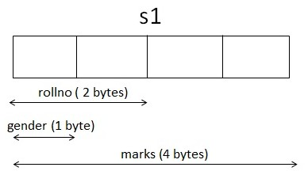
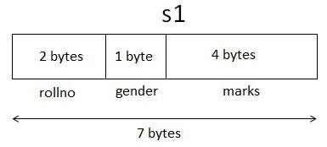
Difference b/w Structure & Union continue…
19
Pictorial Representation
Structure
Union

Slide 28
Difference b/w Structure & Union cont…
20
Structure | Union
We can access any member in any sequence. s1.rollno = 20; s1.marks = 90.0; printf(“%d”,s1.rollno); | We can access only that variable whose value is recently stored. s1.rollno = 20; s1.marks = 90.0; printf(“%d”,s1.rollno); The above code will show erroneous output. The value of rollno is lost as most recently we have stored value in marks. This is because all the members share same memory space.
All the members can be initialized while declaring the variable of structure. | Only first member can be initialized while declaring the variable of union. In above example, we can initialize only variable rollno at the time of declaration of variable.

Slide 29
Pointers
21
int i = 10;
What the declaration tells the C compiler?
Reserve space in memory to hold the integer value
Associate the name i with this memory location
Store the value 10 at this location
Memory Map
Code Snippet
#include <stdio.h>
int main()
{
int intVariable = 10;
printf(“Address of intVariable = %u”, &intVariable); printf(“Value of intVariable = %d”, intVariable); return 0;
}
i
Location Name
10
Value at Location
XXXXX (e.g. 6458)
Location Number
A pointer is a variable whose value is the address of another variable, i.e., direct address of the memory location. Like any variable or constant, you must declare a pointer before using it to store any variable address. The general form of a pointer variable declaration is − type *var-name;

Slide 30
Pointers cont…
22
Code Snippet 1
Code Snippet 2
#include <stdio.h>
int main()
{
int i = 10; int *j;
j = &i; return 0;
}
#include <stdio.h>
int main()
{
int i = 10, *j, **k; j = &i;
k = &j; return 0;
}
Memory Map
Memory Map
i
10
6458
j
6458
7455
i
10
6458
j
6458
7455
k
7455
8452

Slide 31
Pointers cont… NULL Pointers
23
It is always a good practice to assign a NULL value to a pointer variable in case you do not have an exact address to be assigned. This is done at the time of variable declaration. A pointer that is assigned NULL is called a null pointer.
The NULL pointer is a constant with a value of zero defined in several standard libraries.
Code Snippet
# include <stdio.h> int main()
{
int *ptr = NULL;
printf("The value of ptr is : %u\n", ptr ); return 0;
}
Null Pointer Checking
if (ptr == null) or if (ptr <> null)
If (ptr) or if ( !ptr)
Commonly done mistakes
int c, *pc;
pc=c; /* pc is address whereas, c is not an address. */
*pc=&c; /* &c is address whereas, *pc is not an address. */

Slide 32
Dynamic Memory Allocation
24
The exact size of array is unknown until the compile time i.e. time when a compiler compiles code written in a programming language into a executable form. The size of array you have declared initially can be sometimes insufficient and sometimes more than required.
What?
The process of allocating memory during program execution is called dynamic memory allocation. It also allows a program to obtain more memory space, while running or to release space when no space is required.
Difference between static and dynamic memory allocation
Sr # | Static Memory Allocation | Dynamic Memory Allocation
1 | User requested memory will be allocated at compile time that sometimes insufficient and sometimes more than required. | Memory is allocated while executing the program.
2 | Memory size can‟t be modified while execution. | Memory size can be modified while execution.

Slide 33
Dynamic Memory Allocation cont…
25
Functions available in C for memory management
Sr # | Function | Description
1 | void *calloc(int num, int size) | Allocates an array of num elements each of which size in bytes will be size.
2 | void free(void *address) | Releases a block of memory block specified by address.
3 | void *malloc(int num) | Allocates an array of num bytes and leave them initialized.
4 | void *realloc(void *address, int newsize) | Re-allocates memory extending it up to new size.

Slide 34
Dynamic Memory Allocation Example
26
#include <stdio.h> #include <stdlib.h> int main()
{
int *pi; float *pj;
*pi = 10;
*pj = 3.56;
printf(“integer = %d, float = %f”, *pi, *pj);
return 0;
}
#include <stdio.h> #include <stdlib.h> int main()
{
int *pi; float *pj;
pi = (int *) malloc(sizeof(int));
pj = (float *) malloc(sizeof(float));
*pi = 10;
*pj = 3.56;
printf(“integer = %d, float = %f”, *pi, *pj); free(pi);
free(pj); return 0;
}
pi = (int *) malloc(sizeof(int));
pj = (float *) malloc(sizeof(float));
if (!pi || !pj)
{
printf(“Insufficient Memory”); return;
}
I M H
free(pi);
free(pj);
IMH : Insufficient Memory Handling

Slide 35
DMA realloc Example
27
#include <stdio.h> #include <stdlib.h> int main()
{
C Program illustrating the usage of realloc
char *mem_allocation;
/* memory is allocated dynamically */ mem_allocation = malloc( 20 * sizeof(char) ); if( mem_allocation == NULL )
{
printf("Couldn't able to allocate requested memory\n"); return;
}
else
{
strcpy( mem_allocation,“dynamic memory allocation for realloc function");
}
printf("Dynamically allocated memory content : %s\n", mem_allocation );
mem_allocation=realloc(mem_allocation,100*sizeof(char));
if( mem_allocation == NULL )
{
printf("Couldn't able to allocate requested memory\n");
}
else
{
strcpy( mem_allocation,"space is extended upto 100 characters");
}
printf("Resized memory : %s\n", mem_allocation ); free(mem_allocation);
return 0;
}

Slide 36
Difference between calloc and malloc
28
Sr # | malloc | calloc
1 | It allocates only single block of requested memory | It allocates multiple blocks of requested memory
2 | doesn‟t initializes the allocated memory. It contains garbage values. | initializes the allocated memory to zero
3 | int *ptr; ptr = malloc( 20 * sizeof(int)); For the above, 20*2 bytes of memory only allocated in one block. Total = 40 bytes | int *ptr; Ptr = calloc( 20, 20 * sizeof(int)); For the above, 20 blocks of memory will be created and each contains 20*2 bytes of memory. Total = 800 bytes

Slide 37
Algorithm Specification
29
An algorithm is a finite set of instructions that, if followed, accomplishes a particular task. In addition, all algorithms must satisfy the following criteria:
Input. There are zero or more quantities that are externally supplied.
Output. At least one quantity is produced.
Definiteness. Each instruction is clear and unambiguous.
Finiteness. If we trace out the instructions of an algorithm, then for all cases, the algorithm
terminates after a finite number of steps.
Effectiveness. Every instruction must be basic enough to be carried out, in principle, by a person using only pencil and paper. It is not enough that each operation be definite as in (3); it also must be feasible.
Difference between an algorithm & program – program does not have to satisfy the 4th condition.
Describing Algorithm
Natural Language – e.g. English, Chinese - Instructions must be definite and effectiveness.
Graphics representation – e.g. Flowchart - work well only if the algorithm is small and simple.
Pseudo Language -
Readable
Instructions must be definite and effectiveness
Combining English and C

Slide 38
Algorithm Specification cont…
30
Describing Algorithm – Natural Language
Problem - Design an algorithm to add two numbers and display result.
Step 1 − START
Step 2 − declare three integers a, b & c
Step 3 − define values of a & b
Step 4 − add values of a & b
Step 5 − store output of step 4 to c Step 6 − print c
Step 7 − STOP
Problem - Design an algorithm find the largest data value of a set of given positive data values
Step 1 − START
Step 2 − input NUM Step 3 – LARGE = NUM
Step 4 − While (NUM >=0)
if (NUM > LARGE) then LARGE = NUM
input NUM
Step 5 – display “Largest Value is:”, LARGE Step 6 − STOP
Note - Writing step numbers, is optional.

Slide 39
Algorithm Specification cont…
31
Describing Algorithm – Flowchart
Problem – Write an algorithm to determine a student’s final grade and indicate whether it is passing of failing. The final grade is calculated as the average of five marks.
Start
Input M1 to M5
Grade = (M1 + M2 + M3 + M4 + M5) / 5
Is Grade < 4.0
Print “Fail”
Print “Pass”
Stop

Slide 40
Pseudo Language
32
The Pseudo language is neither an algorithm nor a program. It is an abstract form of a program. It consists of English like statements which perform the specific operations. It employs programming-like statements to depict the algorithm and no standard format (language independent) is followed. The statements are carried out in a order & followings are the commonly used statements.
Statement | Purpose | General Format
Input | Get Information | INPUT: Name of variable e.g. INPUT: user_name
Process | Perform an atomic activity | Variable ← arithmetic expression e.g. x ← 2 or x ← x + 1 or a ← b * c
Decision | Choose between different alternatives | IF (condition is met) then statement(s) ENDIF | IF (condition is met) THEN statement(s) ELSE statements(s) ENDIF
 |  | e.g. IF (amount < 100) THEN interestRate ← .06 ENDIF | e.g. IF (amount < 100) THEN interestRate ← .06 ELSE interest Rate ← .10 ENDIF

Slide 41
Pseudo Language cont…
33
Statement | Purpose | General Format
Repetition | Perform a step multiple times | REPEAT statement(s) UNTIL (condition is met) | WHILE (condition is met) statement(s) ENDWHILE
 |  | e.g. count ← 0 REPEAT ADD 1 to count OUTPUT: count UNTIL (count < 10) OUTPUT: “The End” | e.g. count ← 0 WHILE (count < 10) ADD 1 to count OUTPUT: count ENDWHILE OUTPUT: “The End”
Output | Display information | OUTPUT: Name of variable e.g. OUTPUT: user_name | OUTPUT: message OUTPUT: „Credit Limit‟ limit

Slide 42
Pseudo Language Guidelines
34
Guidelines |  | Explanation
Write only one statement per line |  | Each statement in pseudo code should express just one action for the computer. If the task list is properly drawn, then in most cases each task will correspond to one line of pseudo code. Task List Pseudo code Read name, hours worked, rate of pay INPUT: name, hoursWorked, payRate gross = hours worked * rate of pay gross ← hoursWorked * payRate Write name, hours worked, gross OUTPUT: name, hoursWorked, gross
Capitalize initial keyword |  | In the example above note the words: INPUT and OUTPUT. These are just a few of the keywords to use, others include: IF, ELSE, REPEAT, WHILE, UNTIL, ENDIF
Indent to show hierarchy |  | Each design structure uses a particular indentation pattern. Sequence - Keep statements in sequence all starting in the same column Selection - Indent statements that fall inside selection structure, but not the keywords that form the selection Loop - Indent statements that fall inside the loop but not keywords that form the loop INPUT: name, grossPay, taxes IF (taxes > 0) net ← grossPay – taxes ELSE net ← grossPay ENDIF OUTPUT: name, net
 | School of Computer Engineering

Slide 43
Pseudo code Guidelines cont…
35
Guidelines | Explanation
End multiline structures | INPUT: name, grossPay, taxes IF (taxes > 0) net ← grossPay – taxes ELSE net ← grossPay ENDIF OUTPUT: name, net Watch the IF/ELSE/ENDIF as constructed above, the ENDIF is in line with the IF. The same applies for WHILE/ENDWHILE etc…
Keep statements language independent | Resist the urge to write in whatever language you are most comfortable with, in the long run you will save time. Remember you are describing a logic plan to develop a program, you are not programming!

Slide 44
Pseudo Language Example
36
Problem - Design the pseudo code to add two numbers and display the average.
INPUT: x, y
sum ← x + y average ← sum / 2
OUTPUT: ‘Average is:’ average
Problem - Design the pseudo code to calculate & display the area of a circle
INPUT: radius
area← 3.14 * radius * radius OUTPUT: ‘Area of the circle is ‘ area
2. Problem - Design the pseudo code to calculate & display the largest among 2 numbers
INPUT: num1, num2 max ← num1
IF (num2 > num 1) THEN max ← num2
ENDIF
OUTPUT: ‘Largest among 2 numbers is’ max

Slide 45
Algorithm Specification cont…
37
Example - Translating a Problem into an Algorithm – Combining English and C
Problem - Devise a program that sorts a set of n>= 1 integers
Step I – Concept – looks good but not an algorithm
From those integers that are currently unsorted, find the smallest and place it next in the sorted list – selection sort
Step II – An algorithm, written in C and English for (i= 0; i< n; i++)
{
Examine list[i] to list[n-1] and suppose that the smallest integer is list[min]; Interchange list[i] and list[min];
}
Optional Step III – Coding – translating the algorithm to C program void sort(int *a, int n) {
for (i= 0; i< n; i++) {
int j= i;
for (int k= i+1; k< n; k++) { if (a[k]< a[j]) {
j = k; int temp=a[i]; a[i]=a[j]; a[j]=temp;
}
}
}
}

Slide 46
Algorithm Specification cont…
38
Translating a Problem into an Algorithm cont… Correctness Proof
Theorem
Function sort(a, n) correctly sorts a set of n>= 1 integers. The result remains in a[0], ..., a[n-1] such that a[0]<= a[1]<=...<=a[n-1].
Proof
For i= q, following the execution of lines, we have a[q]<= a[r], q< r< =n-1. For i> q, observing, a[0], ..., a[q] are unchanged.
Hence, increasing i, for i= n-2, we have a[0]<= a[1]<= ...<=a[n-1]

Slide 47
Recursive Algorithm
39
A recursive algorithm is an algorithm which calls itself. In general, recursive computer programs require more memory and computation compared with iterative algorithms, but they are simpler and for many cases a natural way of thinking about the problem. There are 2 types of recursive functions.
Direct recursion Function | Indirect recursion Function
Functions call themselves e.g. function α calls α | Functions call other functions that invoke the calling function again e.g. a function α calls a function β that in turn calls the original function α.
Example – int fibo (int n) { if (n==1 || n==2) return 1; else return (fibo(n-1)+fibo(n-2)); } | Example – int func1(int n) { if (n<=1) return 1; else return func2(n); } int func2(int n) { return func1(n); }

Slide 48
Recursive Algorithm cont…
40
When is recursion an appropriate mechanism?
The problem itself is defined recursively
Statements: if-else and while can be written recursively
Art of programming
Why recursive algorithms ?
Powerful, express an complex process very clearly
Properties - A recursive function can go infinite like a loop. To avoid infinite running of recursive function, there are two properties that a recursive function must have −
Base criteria − There must be at least one base criteria or condition, such that, when this condition is met the function stops calling itself recursively.
Progressive criteria− The recursive calls should progress in such a way that each time a recursive call is made it comes closer to the base criteria.
Implementation - Many programming languages implement recursion by means of
stack.

Slide 49
Recursive Implementation of Fibonacci
41
#include<stdio.h> void Fibonacci(int); int main()
{
int k,n;
long int i=0,j=1,f;
//continuation of program
void Fibonacci(int n)
{
static long int first=0,second=1,sum;
if(n>0)
Base Criteria
printf("Enter the range of the Fibonacci series: "); scanf("%d",&n);
{
sum = first + second; first = second; second = sum; printf("%ld ",sum);
Fibonacci(n-1); Progressive Criteria
printf("Fibonacci Series: "); printf("%d %d ",0,1); Fibonacci(n);
return 0;
}
}
}

Slide 50
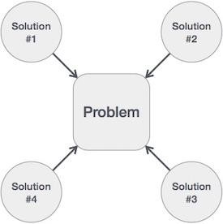
Algorithm Analysis
42
We design an algorithm to get solution of a given problem. A problem can be solved in more than one ways.
Hence, many solution algorithms can be derived for a given problem. Next step is to analyze those proposed solution algorithms and implement the best suitable.

Slide 51
Algorithm Analysis cont…
43
Efficiency of an algorithm can be analyzed at two different implementation and after implementation, as mentioned below −
stages,
before
A priori analysis − This is theoretical analysis of an algorithm. Efficiency of algorithm is measured by assuming that all other factors e.g. processor speed, are constant and have no effect on implementation.
A posterior analysis − This is empirical analysis (by means of direct and indirect observation or experience) of an algorithm. The selected algorithm is implemented using programming language. This is then executed on target computer machine. In this analysis, actual statistics like running time and space required and are collected.
Focus
A priori analysis

Slide 52
Algorithm Complexity
44
Suppose X is an algorithm and n is the size of input data, the time and space used by the Algorithm X are the two main factors which decide the efficiency of X.
Time Factor − The time is measured by counting the number of key operations such as comparisons in sorting algorithm
Space Factor − The space is measured by counting the maximum memory space required by the algorithm.
The complexity of an algorithm f(n) gives the running time and / or storage space required by the algorithm in terms of n as the size of input data.

Slide 53
Space Complexity
45
Space complexity of an algorithm represents the amount of memory space required by the algorithm in its life cycle. Space required by an algorithm is equal to the sum of the following two components −
A fixed part that is a space required to store certain data and variables, that are independent of the size of the problem. For example simple variables & constant used, program size etc.
A variable part is a space required by variables, whose size depends on the size of the problem. For example dynamic memory allocation, recursion stack space etc.
Space complexity SC(P) of any algorithm P is SC(P) = FP + VP (I) where FP is the fixed part and VP(I) is the variable part of the algorithm which depends on instance characteristic I. Following is a simple example that tries to explain the concept −
Algorithm: SUM(A, B) Step 1 - START
Step 2 - C ← A + B + 10
3 variables and data type of each variable is int, So VP(3)
= 3*2 = 6 bytes (No. of characteristic i.e. I = 3)
1 constant (i.e. 10) and it is int, so FP = 1*2 = 2 bytes
Step 3 - Stop
So - SC(SUM) = FP + VP (3) = 2 + 6 = 8 bytes

Slide 54
Space Complexity cont…
46
Example 1
int square(int a)
{
return a*a;
}
In above piece of code, it requires 2 bytes of memory to store variable 'a' and another 2 bytes of memory is used for return value.
That means, totally it requires 4 bytes of memory to complete its execution. And this 4 bytes of memory is fixed for any input value of 'a'. This space complexity is said to be Constant Space Complexity.
If any algorithm requires a fixed amount of space for all input values then that space complexity is said to be Constant Space
Example 2
int sum(int a[], int n)
{
int sum = 0, i;
for(i = 0; i < n; i++) { sum = sum + A[i];} return sum;
In above piece of code it requires -
2*n bytes of memory to store array variable ‘a[]’
2 bytes of memory for integer parameter 'n‘
4 bytes of memory for local integer variables 'sum' and 'i' (2 bytes each)
2 bytes of memory for return value.
That means, totally it requires '2n+8' bytes of memory to complete its execution. Here, the amount of memory depends on the input value of 'n'. This space complexity is said to be Linear Space Complexity.
If the amount of space required by an algorithm is increased
with the increase of input value, then that space complexity is
}
Complexity
said to be Linear Space Complexity

Slide 55
Time Complexity
47
Time Complexity of an algorithm represents the amount of time required by the algorithm to run to completion. Time requirements can be defined as a numerical function T(n), where T(n) can be measured as number of steps * time taken by each steps
For example, addition of two n-bit integers takes n steps. Consequently, the total computational time is T(n) = c*n, where c is the time taken for addition of two bits. Here, we observe that T(n) grows linearly as input size increases.
Asymptotic analysis
Asymptotic analysis of an algorithm, refers foundation/framing of its run-time performance.
to defining the mathematical
Asymptotic analysis are input bound i.e., if there's no input to the algorithm it is concluded to work in a constant time. Other than the "input" all other factors are
considered constant.

Slide 56
Time Complexity cont… Asymptotic analysis
48
Asymptotic analysis refers to computing the running time of any operation in mathematical units of computation.
For example,
Running time of one operation is computed as f(n)
May be for another operation it is computed as g(n²)
Usually, time required by an algorithm falls under three types –
Best Case − Minimum time required for program execution.
Average Case − Average time required for program execution.
Worst Case − Maximum time required for program execution.

Slide 57
Time Complexity cont… Best, Average and Worst Case examples
49
Example 1: Travel from Kanyakumari to Srinagar
Worst Case − You go to Ahemdabad and then you take a east go to
Guhwati and then again take a west and go to Srinagar.
Average Case − You go normal route highways only to reach there.
Best Case − Take every short cut possible leave the national highway if you need to take state highway, district road if you need to but you have to get to Srinagar with least possible distance
Example 2: Sequential Search for k in an array of n integers
Best Case − The 1st item of the array equals to k
Average Case − Match at n/2
Worst Case − The last position of the array equals to k

Slide 58
Time Complexity cont… Asymptotic Notations
50
Following are commonly used asymptotic notations used in calculating running time complexity of an algorithm.
Ο Notation – “Big Oh” - The Ο(n) is the formal way to express the upper bound of an algorithm's running time. It measures the worst case time complexity or longest amount of time an algorithm can possibly take to complete.
Ω Notation – “Omega” - The Ω(n) is the formal way to express the lower bound of an algorithm's running time. It measures the best case time complexity or best amount of time an algorithm can possibly take to complete.
θ Notation – “Theta” - The θ(n) is the formal way to express both the lower bound and upper bound of an algorithm's running time.

Slide 59
Time Complexity cont… Asymptotic Notations cont…
51
Sr # | Algorithm | Time Complexity
 |  | Best | Average | Worst
1 | Bubble Sort | Ω(n) | Θ(n²) | O(n²)
2 | Insertion Sort | Ω(n²) | Θ(n²) | O(n²)
3 | Quick Sort | Ω(n log n) | Θ(n log n) | O(n²)
4 | Merge Sort | Ω(n log n) | Θ(n log n) | O(n log n)
5 | Heap Sort | Ω(n log n) | Θ(n log n) | O(n²)
Time-Space Trade Off
The best algorithm to solve a given problem is one that requires less space in memory and takes less time to complete its execution. But in practice it is not always possible to achieve both these objectives. As we know there may be more than one approach to solve a particular problem. One approach may take more space but takes less time to complete its execution while the other approach may take less space but takes more time to complete its execution. We may have to sacrifice one at the cost of the other. If space is our constraint, then we have to choose a program that requires less space at the cost of more execution time. On the other hand if time is our constraint then we have to choose a program that takes less time to complete its execution at the cost of more space.

Slide 60
Time Complexity Rules
52
Time complexity of a function (or set of statements) is considered as O(1) if it doesn’t contain loop, recursion and call to any other non-constant time function. Example:
void swap(int *x, int *y)
{
int temp; temp=*x;
*x=*y;
*y=temp;
}
Time complexity of swap function= Total number of simple statements = 4 = constant = O(1)
Note -
Constant Time - algorithm runs in a fixed amount of time, it just means that it isn't proportional to the length/size/magnitude of the
input. i.e., for any input, it can be computed in the same amount of time (even if that amount of time is really long).

Slide 61
Time Complexity Rules for Loops
53
A loop or recursion that runs a constant number of times is also considered as
O(1). Example -
int i;
for (i = 1; i <= c; i++) // c is a constant
{
// some O(1) expressions
}
Time Complexity of a loop is considered as O(n) if the loop variables i is
incremented / decremented by a constant amount c. Example - for (i = 1; i <= n; i = i+c)
{
// some O(1) expressions
}

Slide 62
Time Complexity Rules for Loops cont…
54
Time Complexity of a loop is considered as O(log n) if the loop variables i is multiplied or divided by a constant amount c. Example -
for (i = 1; i <= n; i=i*c)
{
// some O(1) expressions
}
Time Complexity of a loop is considered as O(log log n) if the loop variables i if the loop variables is reduced / increased exponentially by a constant amount c. Example -
Example 1 | Example 2
Here c is a constant greater than 1 for (i = 2; i <= n; i=pow(i,c)) { // some O(1) expressions } | //Here fun is sqrt or cuberoot or any other constant root for (i = n; i > 0; i = fun(i)) { // some O(1) expressions }

Slide 63
Time Complexity Rules for Loops cont…
55
Time complexity of nested loops is equal to the number of times the innermost statement is executed that is nothing but the multiplication of outer loop complexity into inner loop complexity.
Sr # | Program Segment | Time Complexity | Explanation
1 | int i, j, k; for (i = 1; i <=m; i ++) { for (j = 1; j <=n; j ++) { k=k+1; } } | O(m*n) If m = n, then O(n²) | Outer for m times and inner for n times, so total m*n times
2 | int i, j, k; for (i = n; i >1; i =i-2) { for (j = 1; j <=n; j=j+3) { k=k+1; } } | O(n²) | Outer loop approx n times and inner approx n times, so total n² times.

Slide 64
Time Complexity Rules for Loops cont…
56
Sr # | Program Segment | Time Complexity | Explanation
3 | int i, j, k; for (i = n; i >1; i =i*2) { for (j = 1; j <=n; j++) { k=k+1; } } | O(n log n) | Outer loop approx log n times, inner loop n times, so total n log n times.
4 | int i, j, k; for (i = 1; i<=n; i=i*2) { for (j =n; j>=1; j=j/2) { k = k +1; } } | O((log n)²) | Outer loop approx log n times and inner loop approx log n times, so total ((log n)² times.

Slide 65
Time Complexity Rules for Loops cont…
57
Sr # | Program Segment | Time Complexity | Explanation
5 | for (i = 1; i<=n; i++) { for (j =1; j<=100; j++) { Simple-Statements; } } | O(n) | The outer loop executes approx. n times, and the innermost 100 times. Here n=O(n) and 100=O(1) constant time. So total = O(n)*O(1) = O(n)
When there are consecutive loops, the time complexity is calculated as sum of time complexities of individual loops and final time complexity is the higher order term in terms of n (the one which is larger than others for larger value of n)
Sr # |  | Program Segment | Time Complexity | Explanation
1 |  | for (int i = 1; i <=m; i += c) { // some O(1) expressions } for (int i = 1; i <=n; i += c) { // some O(1) expressions } | O(m+n) If m=n, then O(2n)=O(n) | First for outer i loop O(m), second for inner i loop O(n) times, so total O(m+n) times
 | School of Computer Engineering

Slide 66
Time Complexity Rules for Loops cont… 1<logn< n <n<nlogn<n²<n³<....<2^{n}<3^{n}<...<n^{n}
58
Sr # | Program Segment | Time Complexity | Explanation
2 | for (int i = 1; i <=n; i *= 2) { // some O(1) expressions } for (int i = 1; i <=n; i ++) { // some O(1) expressions } | O(n) | First for outer i log n times, second inner i it is n times. Now total=log n + n = O(n) as n is asymptotically larger than log n.
3 | int i, j, k,l; for (i = 1; i <=n; i ++) { for (j = 1; j <=n; j=j*2) {p=i+j;} } for ( k = n; k >=1; k=k/3) { q=k+p; } for ( l = n; l >=1; l=l-2) { q=k+p; } | O(n log n) | Nested for-ij loop is executed n log n times. k loop log n times, l loop n times. So total= n log n + log n + n = O(n log n) as n log n > n > log n

Slide 67
Time Complexity Rules for Recursion
59
Sr # | Program Segment | Time Complexity | Explanation
1 | Factorial of a number int Factorial (int n) { if n == 0 then return 0; else return n * Factorial(n – 1) } | O(n) | comparison, multiplication and subtraction are simple statements and each takes 1 unit of time. So T(n) = T(n-1) + 3 if n > 0 T(0) = 1 if n = 0 So T(n) = T(n-1) + 3 = T(n-2) + 6 = T(n-k) + 3k When k = n, T(n) = T(0) + 3n = 3n + 1 So T(n) = O(n)
2 | Fibonacci Sequence int Fib(int n) { if n <= 1 then return 1; else return Fib(n-1) + Fib (n – 2) } | ?? | ??

Slide 68
Space Complexity Rules
60
Sr # | Program Segment | Space Complexity | Explanation
1 | int sum(int x, int y, int z) { int r = x + y + z; return r; } | O(1) | requires 3 units of space for the parameters and 1 for the local variable, and this never changes, so this is O(1).
2 | int sum(int a[], int n) { int r = 0; for (int i = 0; i < n; ++i) { r += a[i]; } return r; } | O(n) | requires n units for a, plus space for n, r and i, so it's O(n).
3 | void matrixAdd(int a[], int b[], int c[], int n) { for (int i = 0; i < n; ++i) { c[i] = a[i] + b[j] } } | O(n) | requires n units for a, b and c plus space for n, and i, so it's O(n).

Slide 69

Summary
61
Detailed Lessons
Functions, Structures and Unions, Pointers, Dynamic Memory Allocation, Algorithm Specification, Space and Time Complexity
How was the journey?

Slide 70
int a = 0, b = 0; for (i = 0; i < N; i++) { a = a + rand(); } for (j = 0; j < M; j++) { b = b + rand(); }
Find time complexity

Slide 71
int a = 0; for (i = 0; i < N; i++) { for (j = N; j > i; j--) { a = a + i + j; } }
Find time complexity

Slide 72
62

Slide 73

Assignments
63
Find the time complexity of the following code segment
for (i = 1; i <= n; i = i*2)
{
for (j = n; j >= 1; j = j/2) { some statement }
}
for (j = c; j > 0; j--) // consider c as const
{
some statement
}
for (i = n; i <= 1; i = i/c) // consider c as const
{
// some statement
}
Write an recursive algorithm to print from 1 to n (where n > 1)
Write an recursive algorithm to find the k^{th} smallest element of a set S
Write an recursive algorithm to sum the list of numbers

Slide 74
Assignments
64
Find the space complexity of the following code segment int Factorial (int n)
{
if n == 0 then return 0;
else
return n * Factorial(n – 1)
}
Find the time and space complexity of the following code segment
int Fib(int n)
{
if n <= 1 then
return 1;
else
return Fib(n-1) + Fib (n – 2)
}

Slide 75

Home Work (HW)
65
Find the time and space complexity of the following code segment
int GCD(int x, int y)
{
if y == 0 then return x
else if x >= y AND y > 0 return GCD (y, x % y) else
return 0;
}

Slide 76
Home Work (HW)
66
Find the time and space complexity of the following code segment void matrixAddition(int a[][], int b[][], int c[][], int n)
{
int i, j;
for (i = 0; i < n; ++i)
{
for (j = 0; j < n; ++j)
{
c[i][j] = a[i][j] + b[i][j];
}
}
}

Slide 77

Supplementary Reading
67
Watch the following video
https://www.youtube.com/watch?v=8syQKTdgdzc
https://www.youtube.com/watch?v=AL7yO-I5kFU
http://nptel.ac.in/courses/106102064/1
Read the following
https://www.tutorialspoint.com/data_structures_algorithms/

Slide 78
FAQ
68
What is Information - If we arrange some data in an appropriate sequence, then it forms a Structure and gives us a meaning. This meaning is called Information . The basic unit of Information in Computer Science is a bit, Binary Digit. So, we found two things in Information: One is Data and the other is Structure.
What is Data Structure?
A data structure is a systematic way of organizing and accessing data.
A data structure tries to structure data!
Usually more than one piece of data
Should define legal operations on the data
The data might be grouped together (e.g. in an linked list)
When we define a data structure we are in fact creating a new data type
of our own.
i.e. using predefined types or previously user defined types.
Such new types are then used to reference variables type within a program

Slide 79
FAQ cont…
69
Why Data Structures?
Data structures study how data are stored in a computer so that
operations can be implemented efficiently
Data structures are especially important when you have a large amount of information
Conceptual and concrete ways to organize data for efficient storage and manipulation.
ADT
Abstract Data Types (ADT's) are a model used to understand the design of a data structure
'Abstract' implies that we give an implementation-independent view of the data structure
ADTs specify the type of data stored and the operations that support the
data
Viewing a data structure as an ADT allows a programmer to focus on an idealized model of the data and its operations

Slide 80
FAQ cont…
70
Time Complexity of algorithm - Time complexity of an algorithm signifies the total time required by the program to run till its completion. The time complexity of algorithms is most commonly expressed using the big O notation. Time Complexity is most commonly estimated by counting the number of elementary functions performed by the algorithm. And since the algorithm's performance may vary with different types of input data, hence for an algorithm we usually use the worst-case Time complexity of an algorithm because that is the maximum time taken for any input size.
Types of Notations for Time Complexity
Big Oh denotes "fewer than or the same as" <expression> iterations.
Big Omega denotes "more than or the same as" <expression> iterations.
Big Theta denotes "the same as" <expression> iterations.
Little Oh denotes "fewer than" <expression> iterations.
Little Omega denotes "more than" <expression> iterations. idealized model of the data and its operations

